Slide 1
“Tkinter Calculator – Python Project”
DR Paramjeet Kaur Bhatti : 29/8/25

Slide 2
Tkinter and Purpose of the Project
Tkinter is a Python Library used to create graphical user interfaces (GUI).
A GUI is a visual way for users to interact with a computer program , instead of typing commands in text. (For example : Calculator app, Web browsers).
It is easy to use and interactive.
This Project demonstrates a basic calculator that can add, subtracts, multiply and divide.

Slide 3
Import and Creating Main Window
Import tkinter as tk.
Creates the main window(tk.tk()) with a title and specific size(geometry)

Slide 4
Display
Entry box displays numbers and results.
Tk.Entry() creates a single line text box to display numbers and results.
Parameters:
Root : parent window where this entry box will appear.
Width: how many characters fits in the box.
Font type and size.
Bd: border thickness
Relief=‘ridge’ : border style
Grid: places the entry box in the top row of the grid and Column span makes the box span number of columns

Slide 5
Create Number Button click function
Def button_click(number): defines a function that runs when a number button is clicked.
Entry.get(): gets the current value in display.
Entry.delete(0,tk.END): clears the display so we can update it.
Entry.insert(0, current +str(number)): adds the clicked number to the current value and ensures the number is treated as text.
Def clear(): clears everything in the display. Triggered when the C (clear) button is pressed.

Slide 6
Operation functions(add,subtract,multiply,divide) and Equal function
Global first_number, operation allows these variables to be used outside the function.
First_number = float(entry.get()): stores the first number typed by the user.
Operation add, subtract, multiply and divide remembers the type of function.
Equal function performs the correct operation based on what was stored.

Slide 7
Creating buttons
Tk.button(): creates a clickable button.
Parameters:
root -→ parent window, text =“1” -→ label shown on button.
Width and height -→size of button
Command = lambda: button_click(1) -→runs button_click(1) when pressed.
Grid(rows=1, column=0)-→ places button in row1, column 0.
Repeated this for all numbers 0 to 9 and operations +, -, *, /, =, C.

Slide 8
Keep window running
Root.mainloop()
Meaning: starts the Tkinter event loop, keeping the window open.
Without this , the window would open and close immediately.

Slide 9
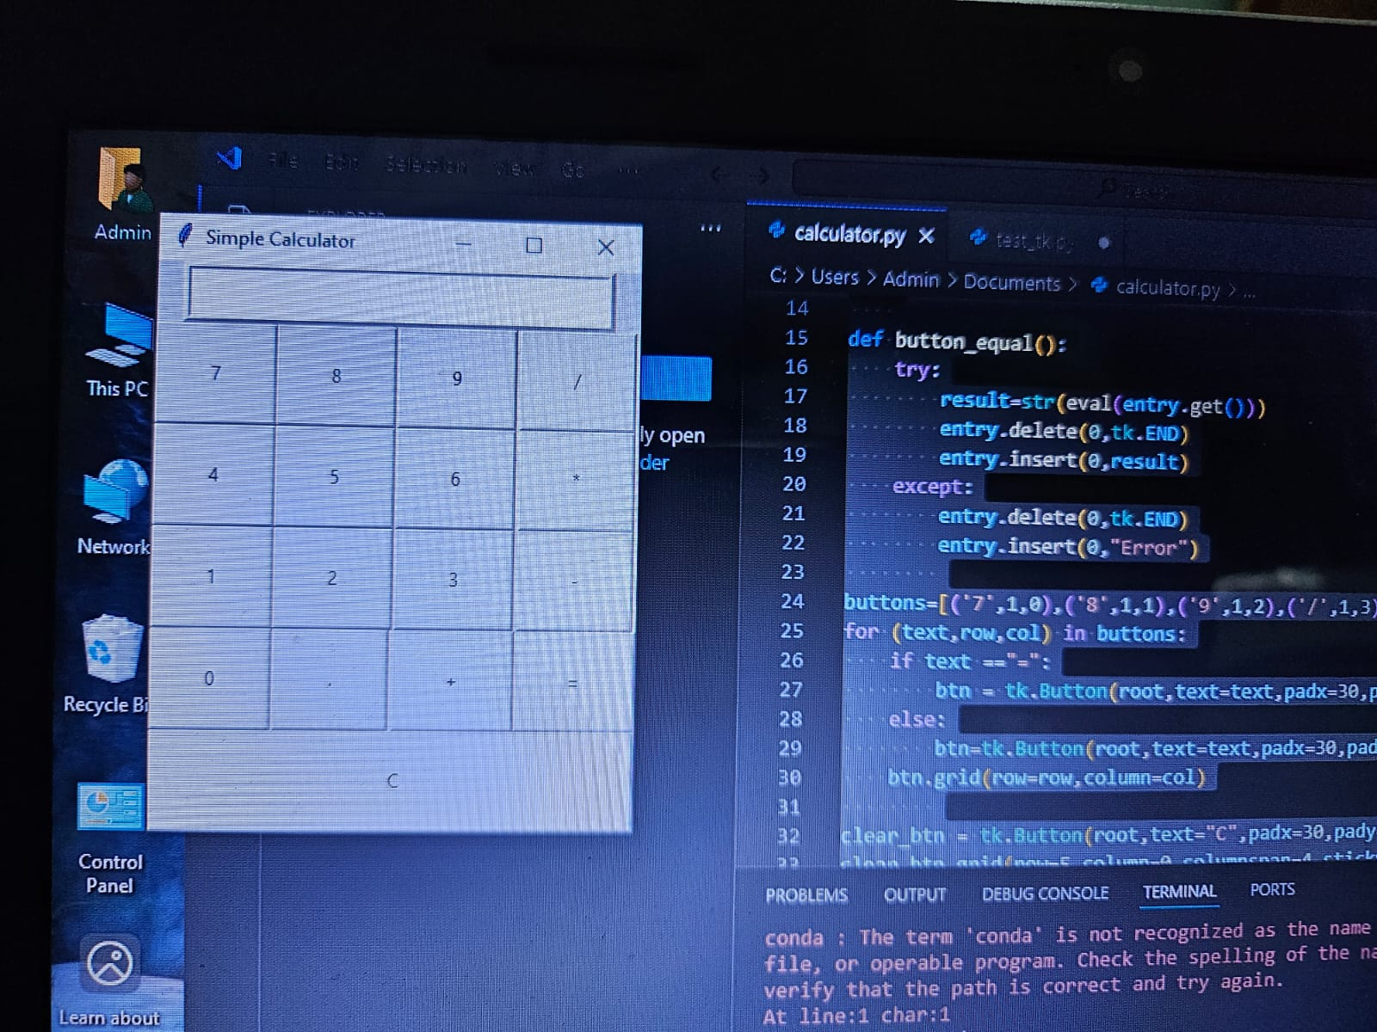
Image Calculator

Slide 10
Summary
Learned Tkinter gui basics and built a calculator performing four operations. Gui allows interactive number entry and button clicks.

Slide 11
Thank You
For giving me such learning opportunity

